Slide 1
OUR LISTENERS ARE AMERICA’S
FASTEST GROWING MARKET and WE KNOW HOW TO REACH THEM!

Slide 2
Facts About Traffic
98% of Americans are exposed to traffic as a driver or a passenger
96% of commuters listen to the radio while they drive each week
70% of Americans claim there is more traffic than a year ago
39% of Americans spend more time in their cars than they did a year ago
31% Increase in U.S. commute times during the past 6 years

Slide 3
Who Is Listening to Traffic Reports?
Commuters driving to and from work
People who react to information provided to them
Captive listeners
People who consume products along the way
People who make stops on the way to their destination
Americans are Time-Starved –
Traffic reaches them when they are a captive audience

Slide 4
Capitol Radio Traffic Systems Network

Slide 5
Hispanic Market Statistics
Metro Area | Hispanic Population | Population Percent Hispanic | Percent Increase from 2000
Miami-Dade | 1,854,759 | 65.70% | + 32%
Hartford | 190,618 | 16.60% | + 59%
Jacksonville | 201,342 | 10.30% | + 41%
Fort Lauderdale | 448,739 | 25.20% | + 44%
Indianapolis | 151,242 | 9.10% | + 72%
West Palm Beach | 295,076 | 22.20% | + 72%
Atlanta | 502,157 | 12.10% | + 103%
Nashville | 100,072 | 10.20% | + 47%
Boston | 687,344 | 15.20% | + 66%
Richmond | 101,135 | 8.70% | + 49%
Tampa | 652,056 | 20.30% | + 61%
Hartford | 201,255 | 16.80% | + 59%
Norfolk | 128,833 | 9.20% | + 94%
Louisville | 94,199 | 5.80% | + 88%
Washington DC | 817,256 | 17.1% | +93%
Total | 6,426,083
Source: Pew Research Center and 2010 US Census

Slide 6
Capitol Radio Traffic Systems Market Statistics & Demographics*
Ranked #1 Spanish Traffic Reporting
Palm Beach, FL
Treasure Coast, FL
Jacksonville, FL
Boston, MA
Norfolk/Hampton Roads, VA
Richmond, VA
Indianapolis, IN
Atlanta, GA
Louisville, KY
Ranked #2 Spanish Traffic Reporting
Miami-Dade, FL
Ft. Lauderdale, FL
Tampa, FL
Philadelphia, PA
Manchester, NH
25+ average age
54% Male; / 46% Female
73% married with children or grandchildren
A majority do not have a regular physician or attorney
31% have consulted with an attorney or legal services provider within the last 6 months
79% are legally residing in the U.S.
77% are employed or retired with benefits
58% are registered voters
A majority are covered by healthcare insurance, Medicare, or Medicaid
Average income of $38,750.00
*Etica Media Survey of Listeners, 12/01/2012 – 12/31/2012
Notes:
*Etica Media Survey of Listeners, 12/01/2012 – 12/31/2012

Slide 7
The Hispanic Community
According to a new Neilsen report:
In recent years the Latino community has amassed a purchasing power of over $1 trillion dollars, and estimated to be $1.5 trillion by 2020.
America’s Latino population will continue to grow, despite recent slowdowns in immigration.
The Hispanic community is the largest to retain its unique cultural heritage – rather than disappear into the American Melting Pot.
Latinos do not exhibit the same patterns as the general market in regards to the use of technology and media; instead they have distinct patterns due to language and culture dynamics.
Latinos display unique product consumption patterns and are not buying in the same ways as the total market.

Slide 8
The Power of Traffic Reports
Largest Audience
Greater reach and frequency than any other broadcast medium.
Listeners Pay Attention
Research has shown that listeners tune in to traffic reports
during both AM and PM commutes.
Purchase Point Proximity
Traffic reports reach people during both their AM and PM commutes when they are most likely to stop and shop.
As many as 62% of commuters regularly shop
during their morning or afternoon commutes!

Slide 9
Traffic Drives Consumers
96% of commuters listen to radio
while driving
77% of commuters travel to and from work alone
39% of commuters spend more time in their cars than they did a year ago
Commuters spend less time in front of other advertising media and are spending more time on their commute seeking accurate and up to date traffic information

Slide 10
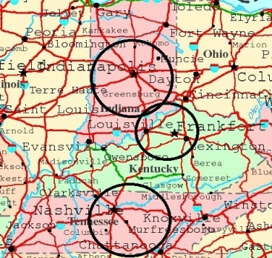
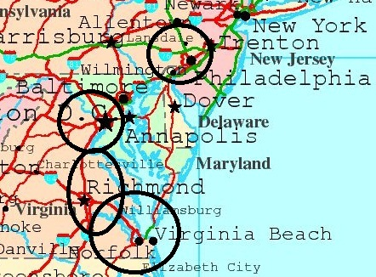
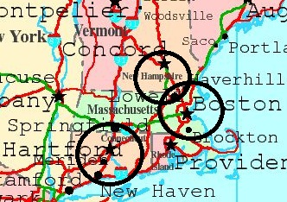
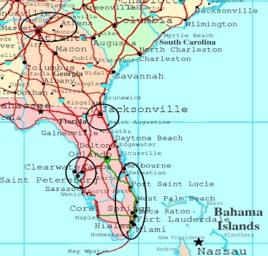
How Sponsoring Traffic Reports Works
Peak Drive Times ONLY: Monday thru Friday
Traffic Report Followed IMMEDIATELY by your powerful :30 second message
Other radio stations in the market only offer :10 second live promotions,
which can leave your message understated and dull
Only YOUR Ad – Your single message accompanied by vital traffic reporting
Unsurpassed reach and greatest frequency in the Hispanic market
Unique medium the in country’s largest growing market

Slide 11
Traffic Reporting Network Stations Southeast
Florida
WURN 1020AM – Miami
WLVJ 1040AM – Broward
WPSP 1190AM – Palm Beach
WJNX 1330AM – Martin / St. Lucie
WJSJ 105.3 – Metro Jacksonville
WYMM 1530AM – Jacksonville
WLCC 760AM – Tampa
WSVU 95.9/106.9/960AM – WPB Seaview Radio
Atlanta
WCHK 1290AM
La Mega 96.5FM

Slide 12
Traffic Reporting Network Stations Northeast
Boston, MA
WNNW 880AM
WNNW 102.9FM
Hartford, CT
WRYM 840AM
Concord, NH
WCCM 1110AM

Slide 13
Traffic Reporting Network Stations Mid Atlantic
Norfolk, VA
WVXX 1050AM
Richmond, VA
WVNZ 1320AM
WTOX 1480AM
Philadelphia, PA
WNAP 1110AM
Metro Washington D.C.
WKDV 1460AM

Slide 14
Traffic Reporting Network Stations Midwest
Louisville, KY
WCND 940AM
Metro Indianapolis, IN
WSYW 810AM
WEDJ 107.1FM
Metro Nashville, TN
WKDA 900AM

Slide 15
Capitol Radio Traffic Systems: 30 Second Advertising Packages
Package | Market | Radio Stations | # of AM Drive Spots per Week /station | # of PM Drive Spots per Week/ station | Total # of Drive Spots / week | Average Price Per Spot | Total Weekly Investment
A | Nationwide | 21 | 15 | 15 | 630 | $50 | $31,500
B | Nationwide | 21 | 10 | 10 | 420 | $60 | $25,200
C | Nationwide | 21 | 6 | 6 | 252 | $70 | $17,650
All Advertising packages are sold on a Weekly Basis
*Local Packages Available
**Schedule includes free live streaming commercial on each of our stations.

Slide 16
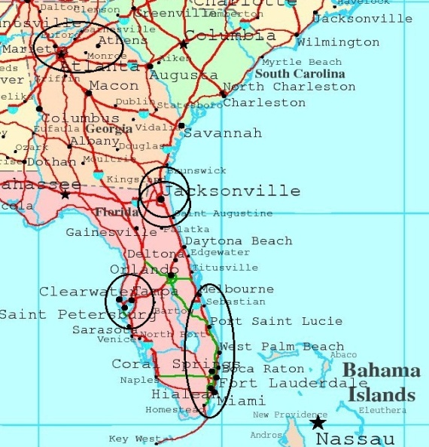
Capitol Radio Traffic Systems :30 Second Advertising Packages – Southeast Region
Package | Market | Radio Stations | # of AM Drive Spots per Week /station | # of PM Drive Spots per Week/ station | Total # of Drive Spots / week | Average Price Per Spot | Total Weekly Investment
A | Southeast | 10 | 15 | 15 | 180 | $55 | $11,550
B | Southeast | 10 | 10 | 10 | 120 | $65 | $9,100
C | Southeast | 10 | 6 | 6 | 72 | $75 | $6,300

Slide 17
Capitol Radio Traffic Systems :30 Second Advertising Packages – Northeast Region
Package | Market | Radio Stations | # of AM Drive Spots per Week /station | # of PM Drive Spots per Week/ station | Total # of Drive Spots / week | Average Price Per Spot | Total Weekly Investment
A | Northeast | 4 | 15 | 15 | 120 | $65 | $7,800
B | Northeast | 4 | 10 | 10 | 80 | $75 | $6,000
C | Northeast | 4 | 6 | 6 | 48 | $85 | $4,080

Slide 18
Capitol Radio Traffic System :30 Second Advertising Packages – Mid-Atlantic Region
Package | Market | Radio Stations | # of AM Drive Spots per Week /station | # of PM Drive Spots per Week/ station | Total # of Drive Spots / week | Average Price Per Spot | Total Weekly Investment
A | Mid-Atlantic | 5 | 15 | 15 | 120 | $55 | $6,600
B | Mid-Atlantic | 5 | 10 | 10 | 80 | $65 | $5,200
C | Mid-Atlantic | 5 | 6 | 6 | 48 | $75 | $3,600

Slide 19
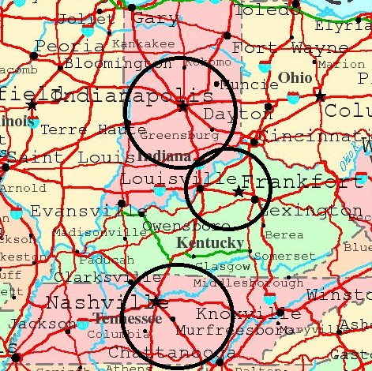
Capitol Radio Traffic Systems :30 Second Advertising Packages – Midwest Region
Package | Market | Radio Stations | # of AM Drive Spots per Week /station | # of PM Drive Spots per Week/ station | Total # of Drive Spots / week | Average Price Per Spot | Total Weekly Investment
A | Midwest | 4 | 15 | 15 | 120 | $50 | $6,000
B | Midwest | 4 | 10 | 10 | 80 | $60 | $4,800
C | Midwest | 4 | 6 | 6 | 48 | $70 | $3,360

